Slide 1
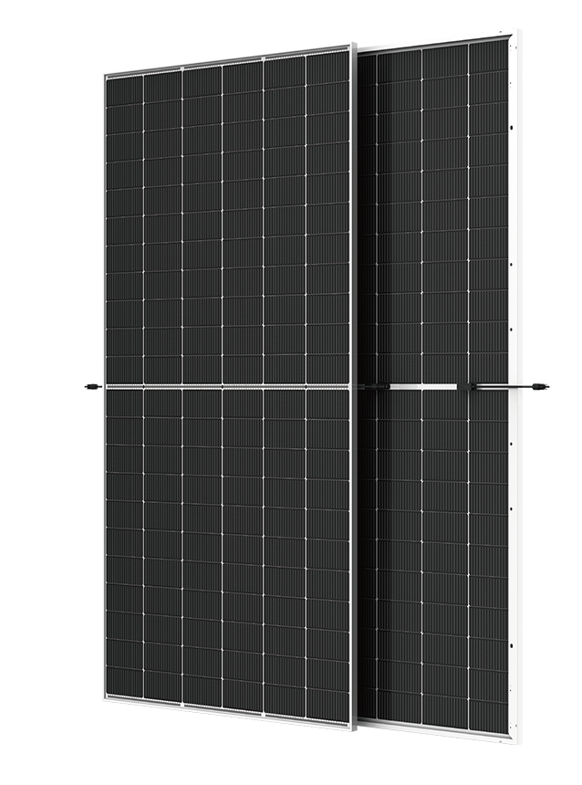












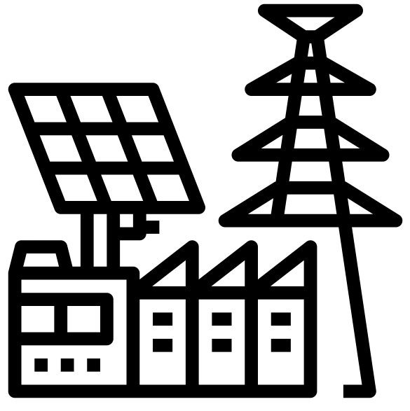








ABS-132GGS-M10
535W – 555W
Topcon Half Cut PV Module
Glass/Glass-Silver Frame
555W
MAXIMUM POWER OUTPUT
+10W
OUTPUT POSITIVE TOLERANCE
Guaranteed 0~+10W positive tolerance ensures power output reliability.
23.4%
MAXIMUM EFFICIENCY
KEY FEATURES
LINEAR PERFORMANCE WARRANTY
LOW SYSTEM COST
Higher yield per surface area, lower BOS costs, higher power classes, and an efficiency rate of up to 23.43%.
100%
99%
95%
^{A}DDED VALUE FROM WARRANTY
Guaranteed Power Performance
87.40%
EXTREME WEATHER RATING
High-tech aluminum alloy frame, certified for high snow (5400 Pa) and wind loads (2400 Pa).
90%
85%
80%
1
5
10
15
20
25
30
ADVANCED MODULE TECHNOLOGY
Highest reliability & enhanced crack tolerance MBB module
Product warranty
30
Years
years
30-year Warranty for Extra Linear Power Output
ALL-WEATHER TECHNOLOGY Optimal
Yields, whatever the weather, with low-light and temperature behaviour.
Product warranty
12
Years
12-year Warranty for Materials and Processing (1st year ≤ 1.0%, 2nd~30th years ≤ 0.40% / year)
BETTER TEMPERTURE COEFFICIENT
Lower temperature coefficient (Pmax):
-0.30%/°C, increases energy yield in hot climate
THE IDEAL SOLUTION FOR
PID
ENDURING HIGH PERFORMANCE
Anti LID and Anti PID Technology. Under long-term production safety conditions, the limited power degradation caused by the PID effect is guaranteed.
Residential
Commercial
Off-Grid
Utility
COMPREHENSIVE CERTIFICATES
ADVANTAGES
IEC 61215 | IEC 61730 | IEC 61701 | IEC 62716
MADE IN UAE
Premium products are 100% made in the Emirates.
A RELIABLE INVESTMENT
Products up to 725Wp, 30 years of performance warranty.
ENCOURAGING INNOVATION
Innovative, prestigious, European production technology
UL 61730 | CEC | ISO 9001 | ISO 14001| ISO 45001
Address: Abundance Solar Panels Industries – LLC Plot No 7-8, KHIA5, KEZAD, Abu Dhabi, UAE

Slide 2
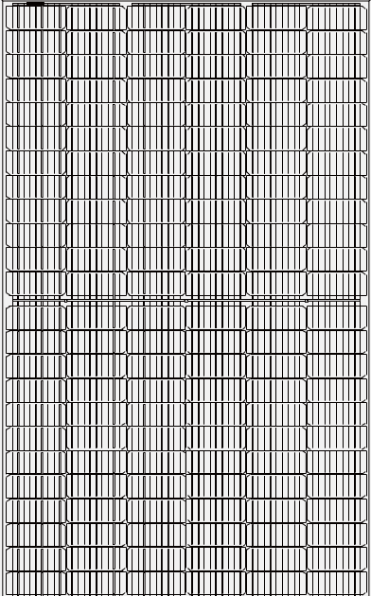

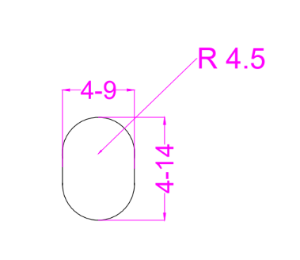

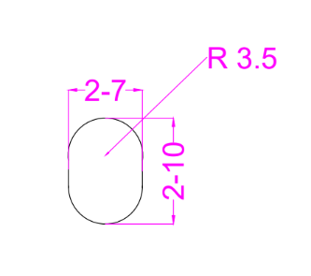
ABS-132GGS-M10-535-555W
ENGINEERING DRAWINGS & TECHNICAL PARAMETERS
ELECTRICAL CHARACTERISTICS (STC/NOCT)
Models | Maximum Rating Power (Pmax) (W) |  | Open Circuit Voltage (Voc) (V) |  | Maximum Power Voltage (Vmp) (V) |  | Short Circuit Current (Isc) (A) |  | Maximum Power Current (Imp) (A) |  | Module Eﬃciency (EFF)(%)
 | STC | NOCT | STC | NOCT | STC | NOCT | STC | NOCT | STC | NOCT
ABS-132GGS-M10-535 | 535 | 399.9 | 47.26 | 44.43 | 40.74 | 38.01 | 14.03 | 11.32 | 13.18 | 10.55 | 22.58%
ABS-132GGS-M10-540 | 540 | 403.6 | 47.42 | 44.59 | 40.88 | 38.14 | 14.08 | 11.36 | 13.29 | 10.64 | 22.80%
ABS-132GGS-M10-545 | 545 | 407.4 | 47.55 | 44.71 | 40.98 | 38.23 | 14.11 | 11.39 | 13.37 | 10.71 | 23.01%
ABS-132GGS-M10-550 | 550 | 411.1 | 47.64 | 44.79 | 41.07 | 38.32 | 14.13 | 11.40 | 13.45 | 10.77 | 23.22%
ABS-132GGS-M10-555 | 555 | 414.9 | 47.76 | 44.90 | 41.18 | 38.42 | 14.14 | 11.41 | 13.52 | 10.83 | 23.43%
*Standard Test Condition (STC): Cell Temperature 25 °C, Irradiance 1000 W/m², AM 1.5, Nominal module operating temperature (NMOT): Air mass AM 1.5, Irradiance 800W/m², temperature 20°C, windspeed 1 m/s. Reduction in eﬃciency from 1000W/m² to 200W/m² at 25°C: 3.5 ± 2%. *Values without tolerance are typical numbers. Measurement tolerance: ± 3%```
BI-FACIAL OUTPUT-BACKSIDE POWER GAIN
Models |  | ABS-132GGS-M10-535 | ABS-132GGS-M10-540 | ABS-132GGS-M10-545 | ABS-132GGS-M10-550 | ABS-132GGS-M10-555
10% | Power | 589 | 594 | 600 | 605 | 611
 | Eff | 24.84% | 25.07% | 25.31% | 25.54% | 25.77%
15% | Power | 615 | 621 | 627 | 633 | 638
 | Eff | 25.97% | 26.21% | 26.46% | 26.70% | 26.94%
20% | Power | 642 | 648 | 654 | 660 | 666
 | Eff | 27.10% | 27.35% | 27.61% | 27.86% | 28.11%
25% | Power | 669 | 675 | 681 | 688 | 694
 | Eff | 28.23% | 28.49% | 28.76% | 29.02% | 29.29%
Solar Cell | Topcon 182.2 x 91.88 mm M10 ,16BB
No.of cells | 132 (6×22)
Dimensions | 2089 mm x 1134 mm x 30 mm ( 82.24” x 44.65“ x 1.18” inch)
Weight | 29 kg / 63.93 lbs.(±3%)
Front Glass | 2.0 mm, High Transmission, Low Iron, Tempered ARC Glass
Cell Encapsulation | EPE(Expanded polyethylene) & EVA (Ethylene-Vinyl-Acetate)
Back Glass | 2.0 mm Semi Tempered Glass with Glaze
Frame | Silver Anodized Aluminum Alloy Type 6005T6 , Silver Color
Junction Box | IP68, 1500VDC, 3 Bypass Diodes
Connectors Type | IP68 MC4 Compatible
Cable | 400mm or 1300 mm, 4mm²
Package Conﬁguration | 36 pcs Per Pallet, 792 pcs per 40’ FT container ( Two pallets=One stack )
CURRENT-VOLTAGE CURVE UNDER DIFFERENT IRRADIANCE

